Slide 1
GWUAN WEBINAR MARCH 23, 2024 NATO/US-BASES IN FINLAND
Ulla Klötzer
Women for Peace - Finland

Slide 2
Finland became the 31st NATO member in April 2023 – without any open and honest debate about obligations and consequences
The political elite used the Ukraine war as a trigger
Exactly the same procedure was used for the DCA-agreement (Defence Cooperation Agreement)
Prime Minister Orpo DCA: "A significant part of NATO"
15 US military bases soon established in Finland 1 300 km (830 mi) border with Russia.

Slide 3
US bases
in Nordic countries
Finland 15
Sweden 17
Norway 12
With possibilities for
more
+ earlier installations
Denmark 4

Slide 4
DCA/Finland - signed in December 2023
(Defence minister Antti Häkkänen/Secr. of State Anthony Blinken)
Parliament approval required (this spring-piece of cake)
Will be brought into force nationally in Finland by law and a government decree
Opens Finnish land, sea and air forces areas for US presence:
- training of US forces
- prepositioning of defence material
- US soldiers permanently in Finland
- easier movement of military/other personnel

Slide 5
- BBC News 4.4.2023 - Finland: “Nato's border with Russia doubles as Finland joins” 1.300 km – 830 mile - Newsweek – 4.10.2022 : As NATO Member, Finland Could Have Nuclear Weapons 965 km – 600 Miles from Kremlin

Slide 6
RedaktionsNetzwerk Deutschland (RND),
20.1.24 - NATO meeting in Brussels:
Latvia's army chief: “Baltic Sea immediately to be placed under NATO control”
the Baltic Sea to be closed to Russian ships.

Slide 7
St.Petersburg: Second largest city in Russia, 5,5 million inhabitants (Finland 5,5 million)

Slide 8
Kaliningrad oblast/exclave: 490,00 inhabitants

Slide 9
The Suwałki Gap: the border area between Poland and Lithuania
a narrow approx. 65 km (40 mi) long, 155 km (71 mi) wide stretch of land
Only land link between Kaliningrad and the rest of Russia. Passing through EU and NATO members.
June 2022, Lithuania and EU imposed travel restrictions on Russian vehicles, preventing their move across the Gap
July 2023 Lithuania removed rail transit restrictions for Kaliningrad after EU revised its sanction recommendations to only apply to road transit - not rail.

Slide 10
For years it has been dubbed NATO’s Achilles Heel

Slide 11
US and allied nuclear weapons are now being introduced throughout the Nordic countries - not on land (yet) but via operational naval units in all our waters; from the Baltic Sea to the Arctic Ocean
Feb 23 - Australia Defence Department Secretary Greg Moriarty:
"Successive Australian governments have understood and respected the longstanding US policy of neither confirming nor denying the presence of nuclear weapons on particular platforms," …

Slide 12
The Finnish Nuclear Energy Act prohibits: import, manufacture, possession of nuclear explosives, transport of nuclear weapons through Finland, their detonation in Finland
A law amendment is already planned
Finnish government announcement 31.8.2023: According to the Government Programme, the Nuclear Energy Act and the provisions implementing it will be reformed by 2026 at the latest.

Slide 13
Former PM Sanna Marin
NATO mannequin
May 2022
"I have not
closed the door
to any possible
future decisions regarding Finland's Nato membership“…

Slide 14
Iltalehti 5.2.2024 (article about TV debate)
Alexander Stubb (from 1.3.24 President of Finland),
praised Stoltenberg and NATO.
He also stated that:
"Russia and Putin don't understand anything but force.“
"without doubt the nuclear deterrent we get from the United States increases our security,...“
"The fact that Putin is afraid that we have them (nuclear weapons)- and he knows that our legislation does not prevent it - is a deterrent in itself.
We should take all the support and security we can get from NATO,..“
Stubb supports allowing transit of nuclear weapons in Finland.

Slide 15
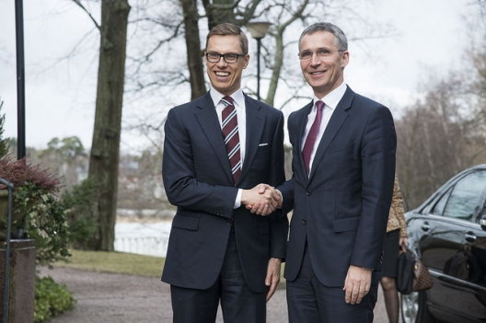

Slide 16
"Steadfast Defender” war games
from end of January to May 31, 2024
largest military exercise in Europe since the Cold War. Approx. 90,000 troops from all 32 NATO allies
Takes place in several key European countries, incl. Finland, Estonia, Germany, Greece, Hungary, Latvia, Lithuania, Norway, Poland, Romania, Slovakia, Sweden, UK

Slide 17
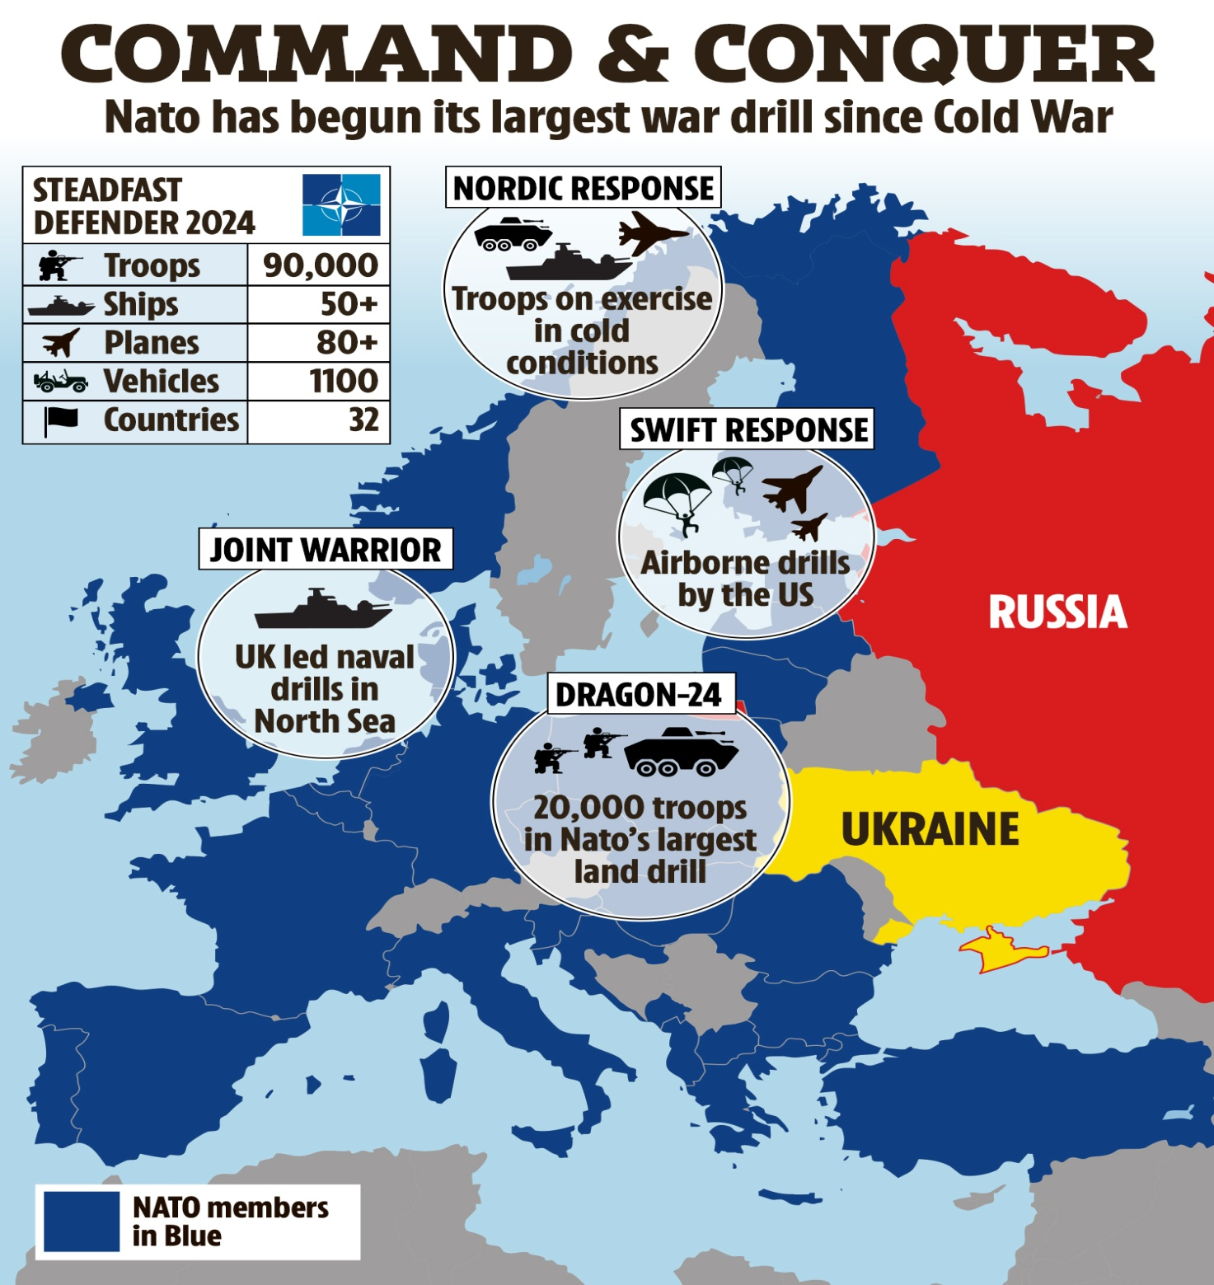

Slide 18
Nordic Response 24
Over 20 000 Soldiers
13 Nations
Practice Defending NATO's Northern Flank
conducted in close cooperation with NATO's overarching exercise Steadfast Defender

Slide 19
BUSINESS INSIDER – January 26, 2024
China's defense ministry
rips NATO
"It's fair to say that NATO is like a walking war machine, wherever it goes, there will be instability,"
said a Chinese defense ministry
spokesperson.

Slide 20
NATO MUST BE DISSOLVED BUT - the US still has some 750 bases in some 80 countries

